Slide 1
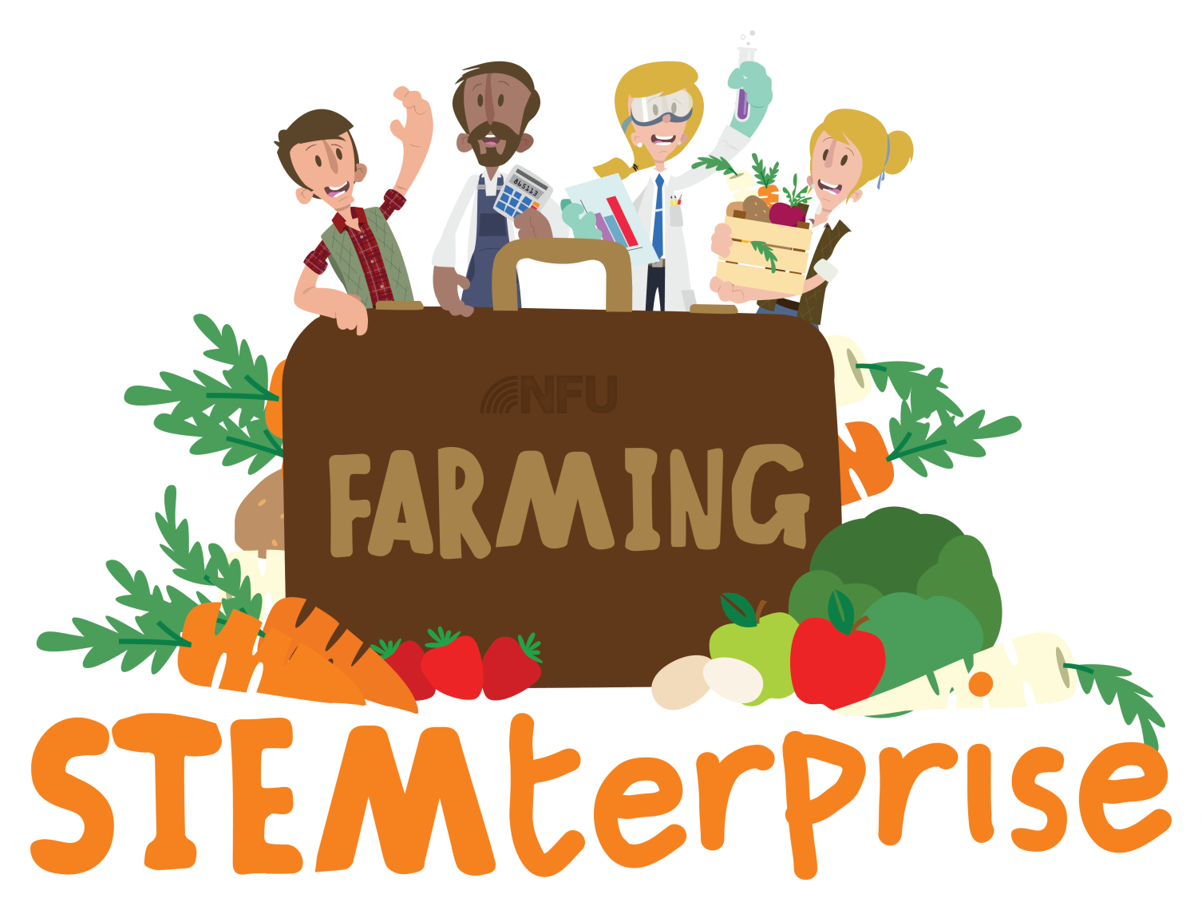
Stage 4: Making a healthy food product

Slide 2
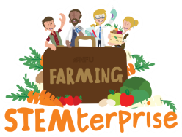
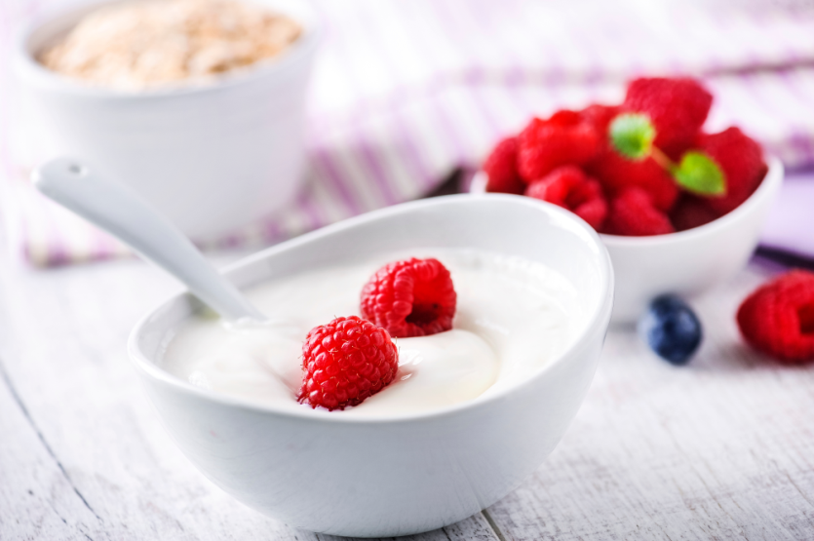
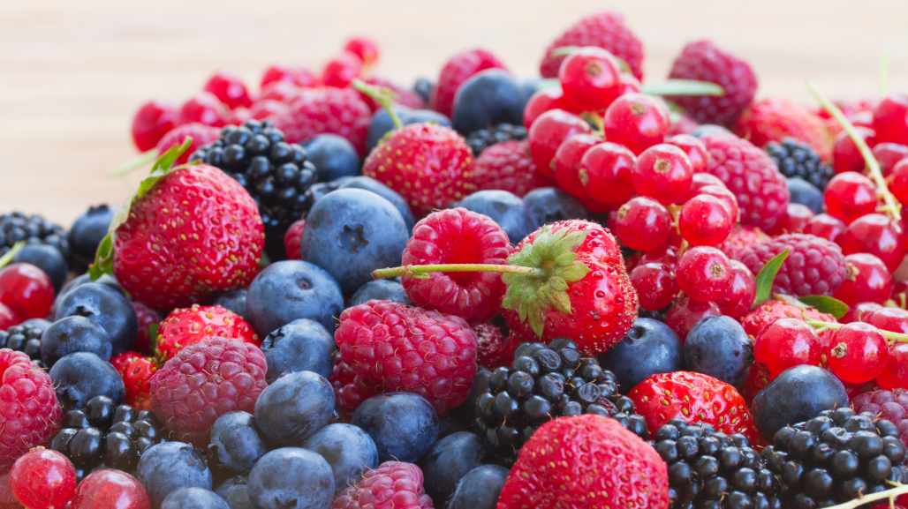
What can we can remember?
Where does yoghurt come from?
Where does fruit come from?

Slide 3
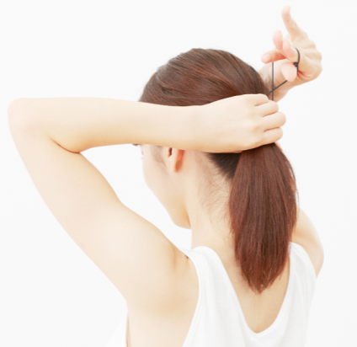
Today, we will be making the British flag yoghurts that we designed.
Let’s get ready!
Wash your hands
Tie up long hair

Slide 4
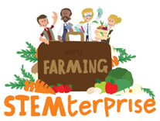
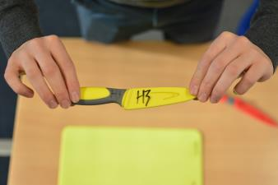
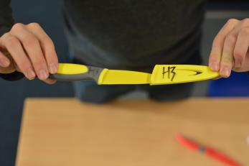
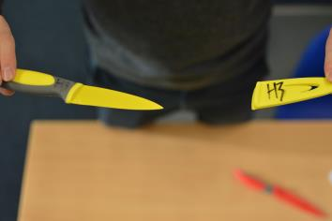
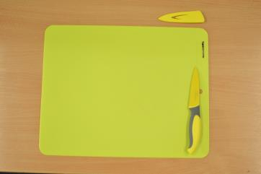
Knife safety
To remove the cover from the knife, pinch the end of the handle and the tip of the knife and face the knife away from you.
Gently, pull the cover away from the knife.
Make sure that you don’t swing your arms and put others in danger.
Your knife is now “active”. Make sure you keep your knife in the safety zone (your chopping board) and if it moves away from your chopping board, you are putting yourself and others in danger.
© Primary Food Tech 2018
Notes:
4

Slide 5
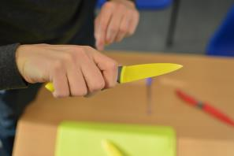
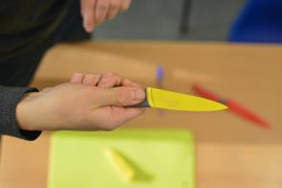
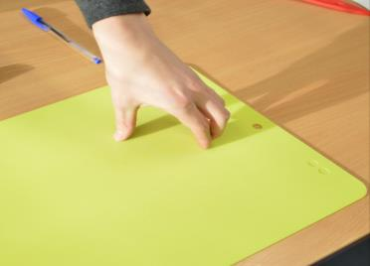
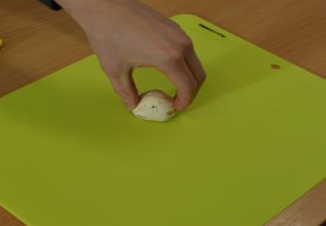
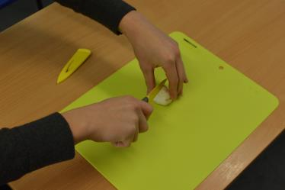
Bridge method
Make sure you have a firm hold on the knife.
Open your hand up. All your fingers need to be together with your thumb on the opposite side.
Grip either side of the food, making sure you have a firm hold.
Put the knife through the middle of your “bridge” to complete the cut.
© Primary Food Tech 2018
Notes:
5

Slide 6
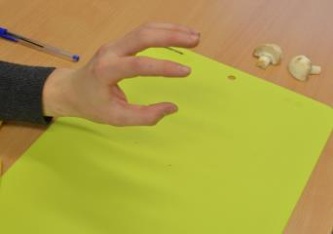
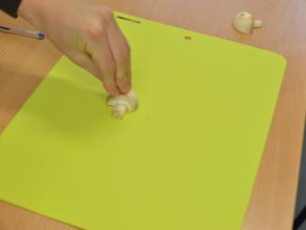
Claw method
Make sure you have a firm hold on the knife.
Hold your hand out and pretend you are “roaring” at someone with your hand.
Make sure your fingers are straight and your thumb is behind your fingers. Hold on tightly with the tips of you fingers.
Slice using the full length of the knife. Remember to keep those fingers straight.
© Primary Food Tech 2018
Notes:
6

